Slide 1
Cells
Guess Who?

Slide 2
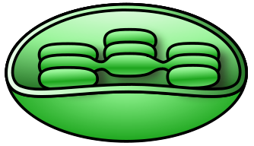
Guess Who?

Slide 3
Chloroplast

Slide 4
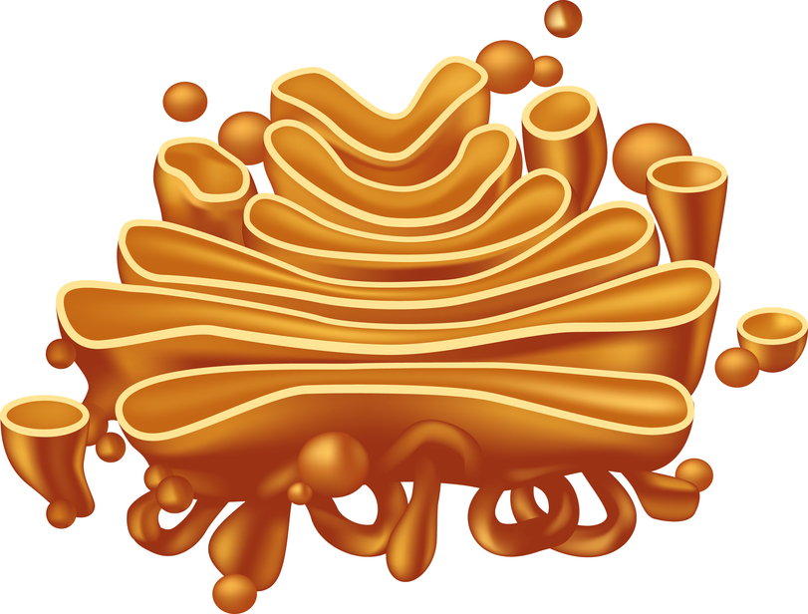
Guess Who?

Slide 5
Golgi Apparatus

Slide 6
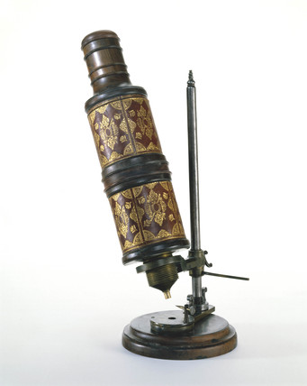
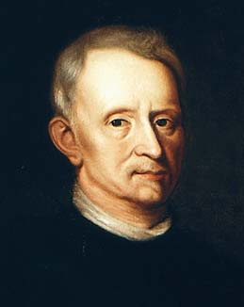
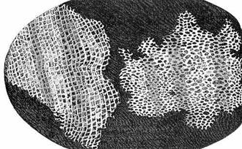
Guess Who?
Used his microscope to observe a thin slice of cork

Slide 7
Hooke

Slide 8
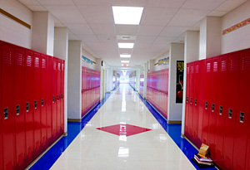
Guess Who?
Can be compared to the hallways of our school

Slide 9
Endoplasmic
reticulum

Slide 10
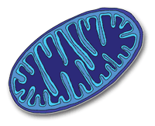
Guess Who?

Slide 11
Mitochondria

Slide 12
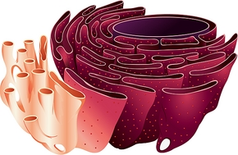
Guess Who?

Slide 13
Endoplasmic
Reticulum

Slide 14
Guess Who?

Slide 15
Ribosomes

Slide 16
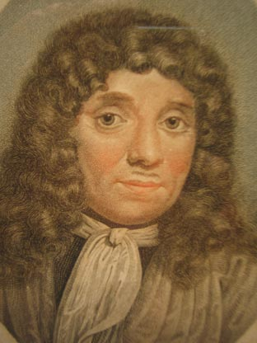
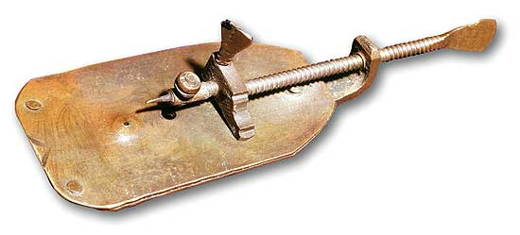
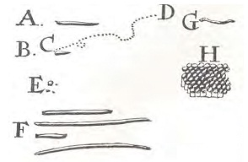
Guess Who?
Was the first to see living cells under a microscope & called them “animalcules”

Slide 17
Leeuwenhoek

Slide 18
Guess Who?
Is known as the “powerhouse” of the cell

Slide 19
Mitochondria

Slide 20
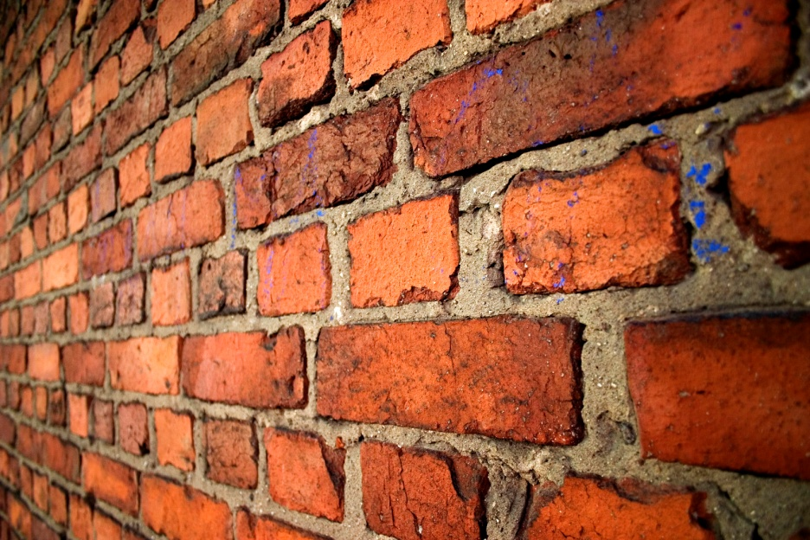
Guess Who?
Is a rigid layer that surrounds the cells of plants & some other organisms

Slide 21
Cell Wall

Slide 22
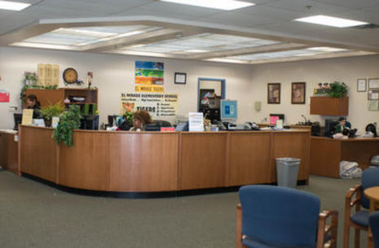
Guess Who?
Can be compared to the front office in our school

Slide 23
Nucleus

Slide 24
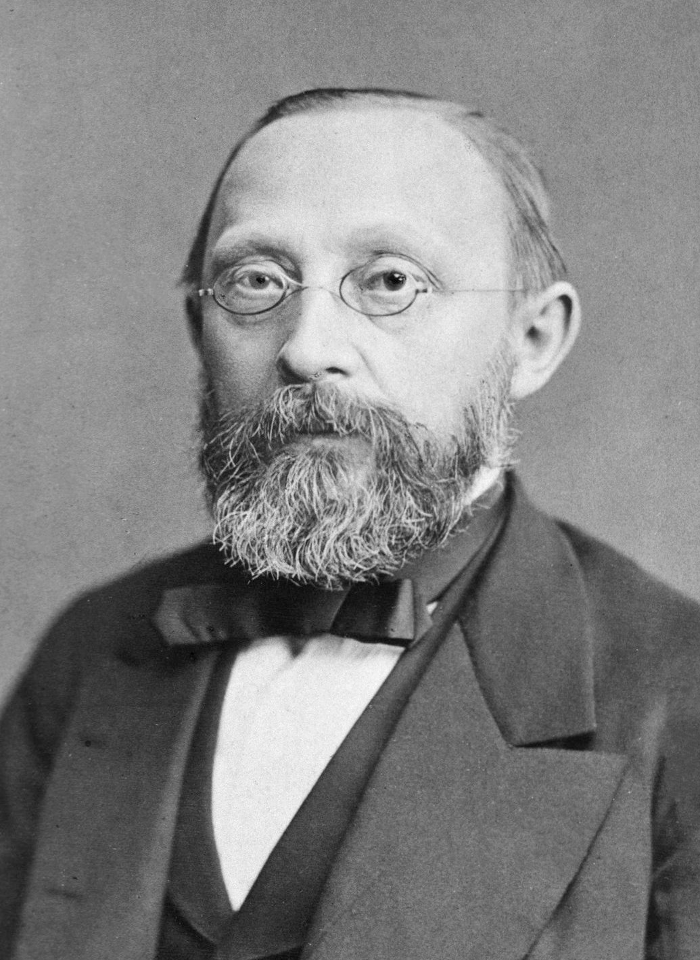
Guess Who?
Proposed that new cells are formed only from cells that already exist

Slide 25
Virchow

Slide 26
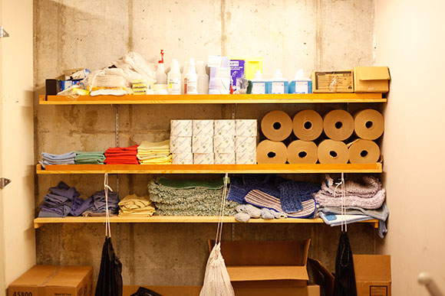
Guess Who?
Can be compared to the custodian’s closet

Slide 27
Vacuole

Slide 28
Guess Who?
Controls which substances pass into and out of a cell

Slide 29
Cell
membrane

Slide 30
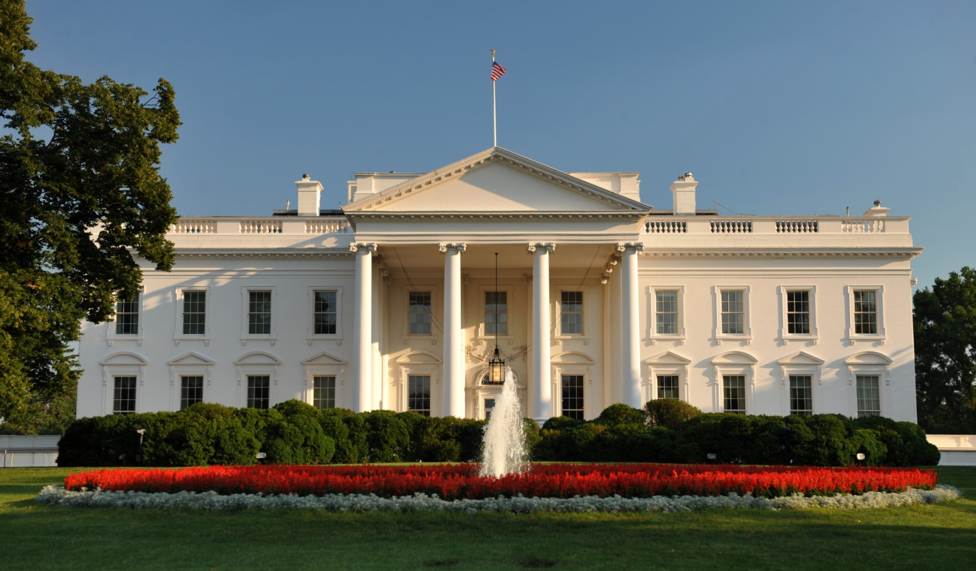
Guess Who?
Acts as a cell’s control center, directing all of the cell’s activities

Slide 31
Nucleus

Slide 32
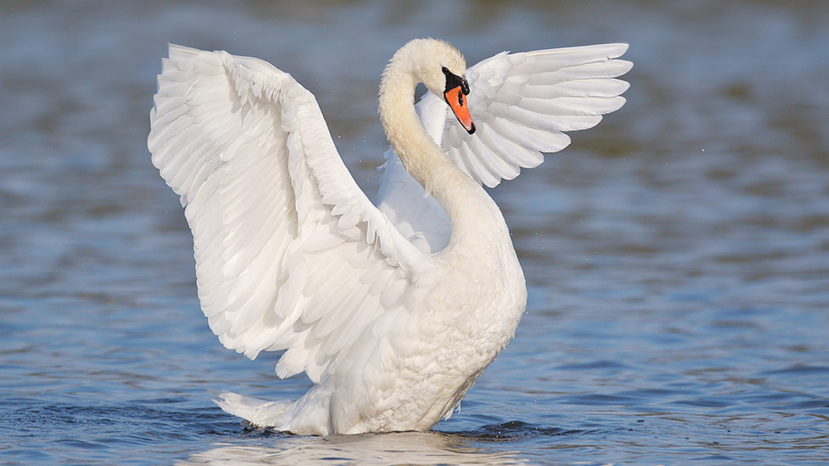
Guess Who?
Concluded that all animals are made of cells

Slide 33
Schwann

Slide 34
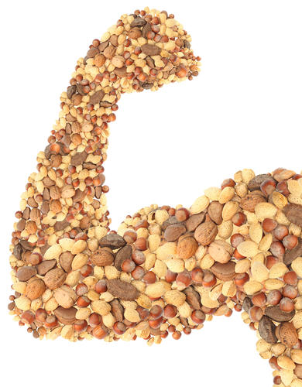
Guess Who?
Produces proteins for the cell

Slide 35
Ribosomes

Slide 36
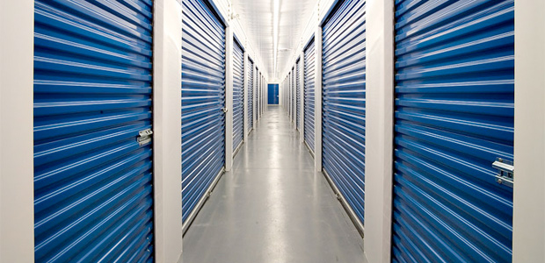
Guess Who?
Stores water, food, or other materials needed by the cell

Slide 37
Vacuole

Slide 38
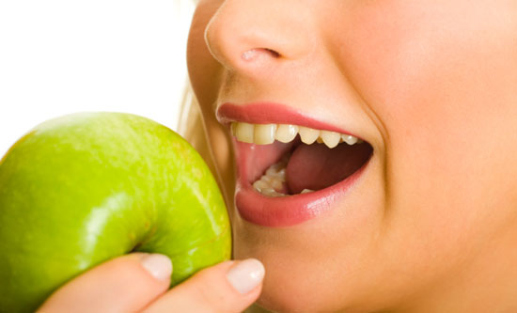
Guess Who?
Breaks down large food particles into smaller ones

Slide 39
Lysosome

Slide 40
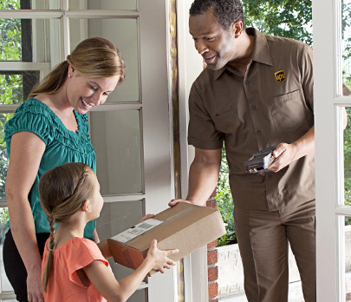
Guess Who?
Receives proteins & other newly formed materials and then packages and distributes them to other parts of the cell or to the outside of the cell

Slide 41
Golgi
apparatus

Slide 42
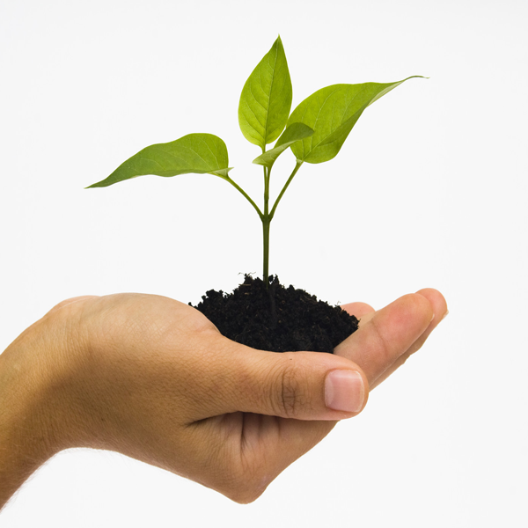
Guess Who?
Concluded that all plants are made of cells

Slide 43
Schleiden

Slide 44
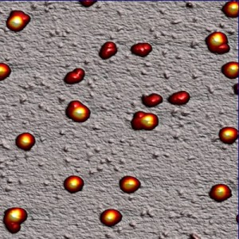
Guess Who?
Ribosomes sometimes attach themselves to

Slide 45
Endoplasmic
reticulum

Slide 46
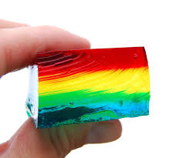
Guess Who?
Fills the region between the cell membrane and the nucleus

Slide 47
Cytoplasm

Slide 48
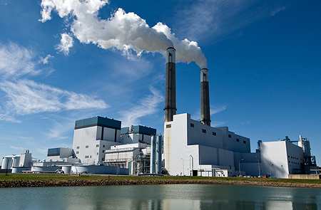
Guess Who?
Converts energy stored in food to energy the cell can use to live & function

Slide 49
Mitochondria

Slide 50
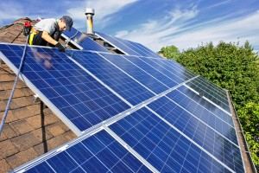
Guess Who?
Captures energy from sunlight and changes it to a form of energy cells can use in making food

Slide 51
Chloroplast

Slide 52
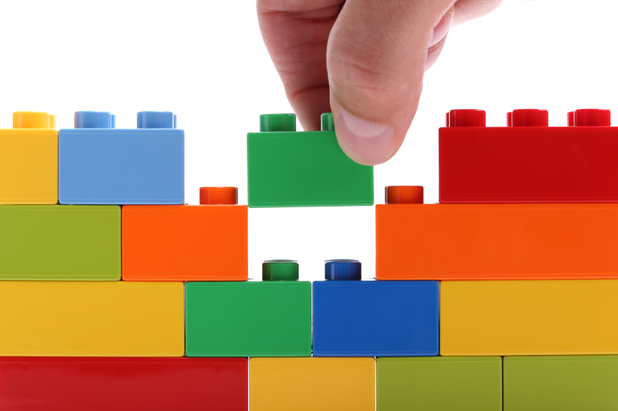
Guess Who?
Are the basic units or “building blocks” of structure & function in living things

Slide 53
Cells

Slide 54
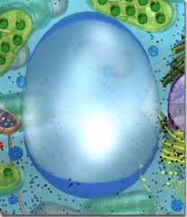
Guess Who?

Slide 55
Vacuole

Slide 56
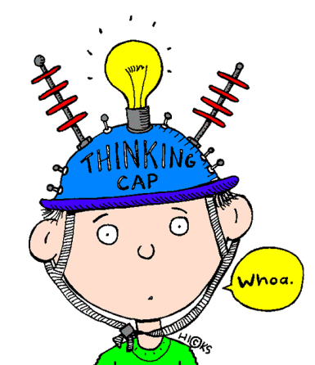
Guess Who?
Are found ONLY in plant cells

Slide 57
Cell wall &
chloroplast

Slide 58
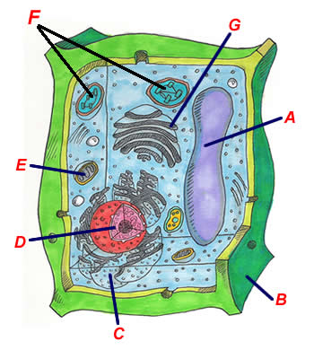
Guess Who? BONUS
Correctly label A – G on your board for FIVE points. You must have all of them correct to get the points!

Slide 59
A – vacuole
B – cell wall
C – endoplasmic reticulum
D- nucleus
E – mitochondria
F – chloroplasts
G – Golgi apparatus

Slide 60
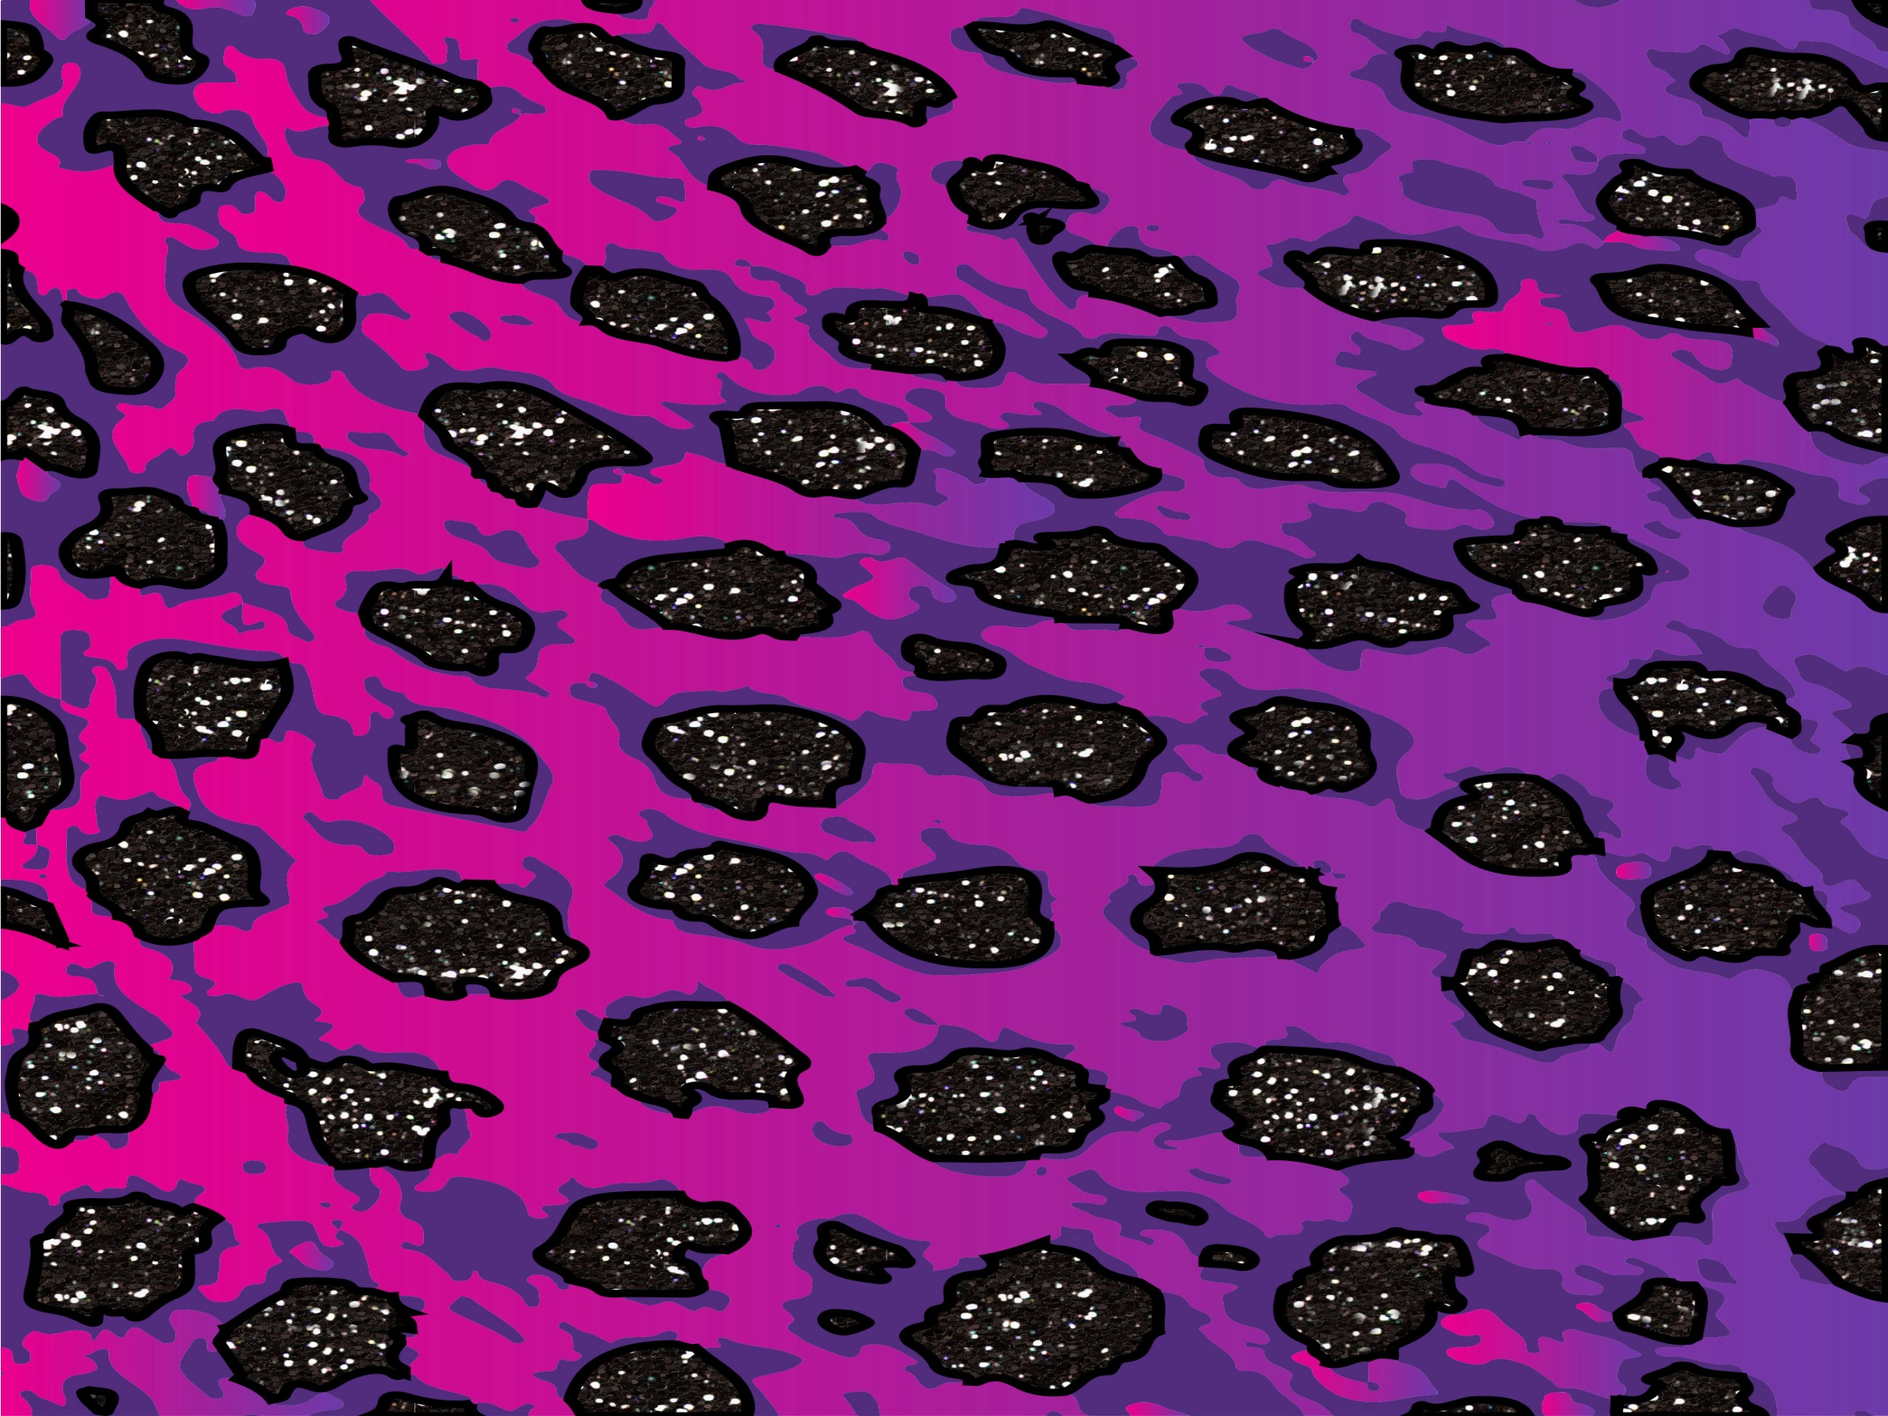
Thank You!
Thank you so much for your download. I truly appreciate your business & I am so excited that you have decided to share my lesson with your students.
Please stop back at my store & let me know how everything went!
http://www.teacherspayteachers.com/store/Science-Chick
(By leaving feedback, you earn TpT credits towards future purchases! ☺)
I use clipart and fonts in my products by these amazing TpT sellers:
For free products & updates on newly listed ones, click “follow me” (right next to my logo) in the upper left corner of my TpT store!
Keep changing lives & making a difference,
Science Chick
© 2015 by Robyn (Science Chick) may be used by the purchaser for their classroom use only. No part of this publication may be reproduced, distributed, or transmitted without the written permission of the author. This includes posting this product on the internet in any form, including classroom/personal websites or network drives. If you wish to share this product with your team or colleagues, you may purchase additional licenses from my store at a discounted price!

